Slide 1
OneBOM and SBOM Update
CBE Staff Meeting - WW29'25
Shelly Kishore

Slide 2

Acknowledgement
CBE-CBD
Hira, Ashish*
Chhabbi, Shreesh
Prakashan, Krishnadas Veliyathuparambil
Pingle, Sneha S
Bandaru, Purna Chandra Rao
Singh, Pradeep Kumar
Shinde, Amol
Lu, James
Prabhala, Varalakshmi A
Patil, Ajit1
Reyes, Darbin
CBE-Security
Adoni Mohammed, Ghouse*
CCE
Palakshareddy, Lavanya C
Ahsan, Mir
OneBOM Team
Balraj, Asha
Sethi, Anil Kumar
Majumdar, Tamal
CBE-Validation
Sapra, Rajesh*
Annamaneni, Ajay K
Bangalore, Naveen*
Shetty, Sunil
Salunke, Manoj
Muthukrishnan, Rambalaji
Muniyandi Selvaraj Manopriya
Chinnathambi, Charlamenan
C4S
Shorey, Chris
Doan, Benjamin

Slide 3
Agenda
What is BOM?
What is OneBOM?
What is SBOM?
How does alignment to OneBOM/SBOM help?
How are OneBOM and SBOM linked?
Status of OneBOM high-level activities/Proposal for future
Status of SBOM high-level activities
Next Steps/Plans
Opens/Help Needed

Slide 4
What is BOM?
Stands for Bill of Materials.
Generic Definition:
Comprehensive list of all the raw materials, components, and instructions needed to manufacture, construct, or repair a product.
like a detailed recipe for creating something, outlining all the ingredients and steps involved.
It typically shows the product in a tree structure, with the final product at the top and individual components below.
Notes:
BOM stands for Bill of Materials. It's a comprehensive list of all the raw materials, components, and instructions needed to manufacture, construct, or repair a product. Essentially, it's like a detailed recipe for creating something, outlining all the ingredients and steps involved.
Here's a more detailed look at what a BOM typically includes:
Components: Lists all the individual parts, sub-assemblies, and raw materials.
Quantities: Specifies how much of each component is needed.
Instructions: Provides guidance on how to assemble the product or perform repairs.
Part Numbers and Descriptions: Helps identify each component and its specifications.
Other Relevant Information: May include details like material type, size, weight, and even cost.
Key Points of a BOM:
Hierarchy: It typically shows the product in a tree structure, with the final product at the top and individual components below.
Details Included:
Part number
Part name
Quantity required
Unit of measure
Reference designators (for electronics)
Procurement type (make or buy)
Manufacturer info (optional)
Types of BOM:
Engineering BOM (EBOM) – Created during product design, focused on how a product is designed.
Manufacturing BOM (MBOM) – Focused on how a product is assembled or built in the factory.
Sales BOM (SBOM) – Used for configured products, showing which items are sold together.

Slide 5
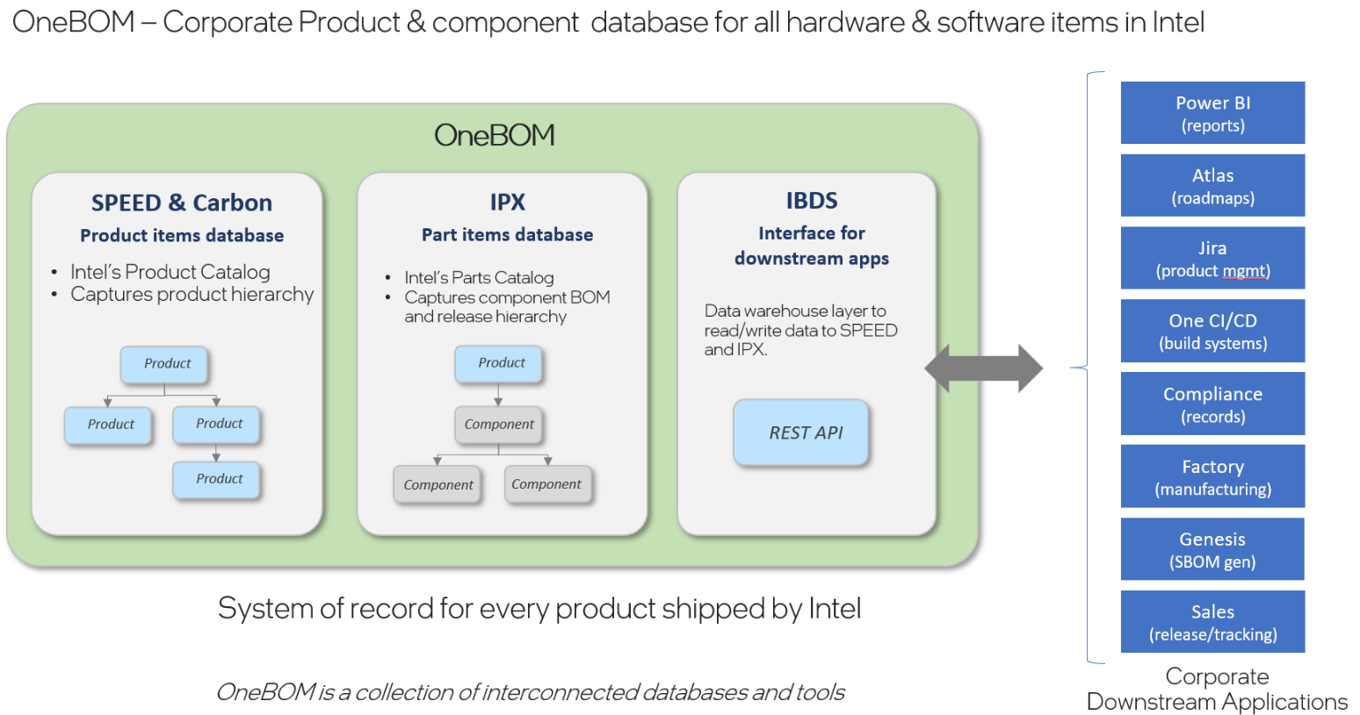
What is OneBOM?
source: http://goto/onebom
Notes:
Intel's Integrated Product Data Management (PDM) Solution and model deployed through new processes and tools, to support up-to-date Bill of Materials for all IP, Hardware, Software and Firmware and to enable traceability and analytics

Slide 6
What is SBOM?
An SBOM (Software Bill of Materials) is a detailed inventory that lists all the components, libraries, and dependencies - both open source and third-party-used in a software.
It typically includes information such as component names, versions, origins, and licenses, providing transparency into the software supply chain.
SBOMs help organizations identify and manage security vulnerabilities, ensure compliance, and improve overall software security by making it easy to track and address risks in software components.

Slide 7
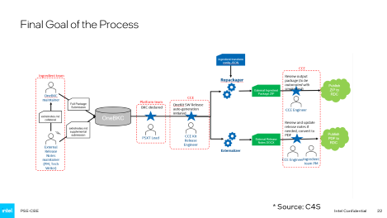

How does alignment to OneBOM help?
Today, after BKC Validation, the CCE team takes ~1 week to send the package to customers.
Once releases are aligned to OneBOM architecture, this would be reduced to only a few hours through automation.
Other long-term benefits of OneBOM includes faster isolation of root cause for regression, CI standardization.

Slide 8
How does alignment to SBOM help?
United States Presidential Executive Order 14028, “Improving the Nation’s Cybersecurity” was passed on May 12th 2021.
Section 4 of the Executive Order , “Enhancing Software Supply Chain Security”, outlines providing the purchaser of the software with an SBOM as one of the requirements for transparency of the supply chain.
Intel’s customers who supply Intel SOC based products are requesting SBOMs for Intel software/firmware that accompanies Intel SOCs.
Federal Government agencies have started requiring SBOMs from their software vendors.
Reference links with more details
https://www.federalregister.gov/documents/2021/05/17/2021-10460/improving-the-nations-cybersecurity
https://www.federalregister.gov/d/2021-10460/p-153
https://www.fda.gov/media/173516/download
https://api.army.mil/e2/c/downloads/2024/10/17/4072ab1e/asaalt-software-bill-of-materials-policy-signed.pdf
*Source: extracted from Lavanya’s TRB presentation

Slide 9
How are OneBOM and SBOM linked?
OneBOM is an Intel initiative that covers both hardware and software.
OneBOM’s software part covers SBOM generation as an output.
SBOM is an industry-level standard, and with the executive order, it is being enforced now.

Slide 10
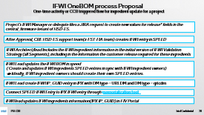
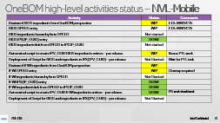
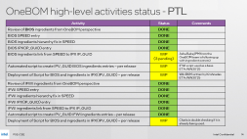
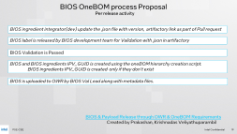
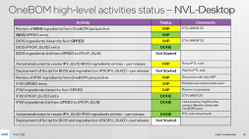
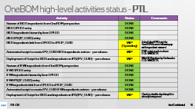
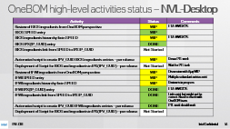
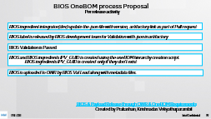
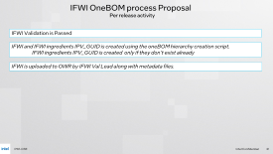
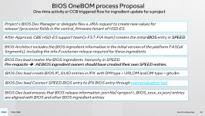
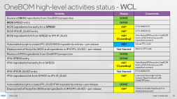
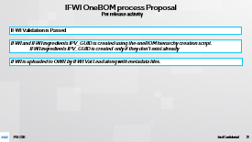
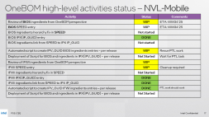
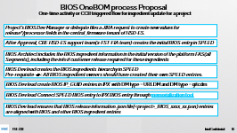
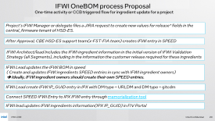
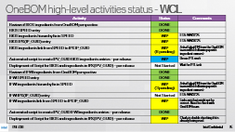
Status of OneBOM high-level activities/Proposal for future
BIOS-Payloads.xlsx
IFWI-Payloads.xlsx
In CBE, OneBOM activities should be incorporated as a regular project execution process
Proposal is ready for CBE internal teams' review. Reviews started. To be completed by WW31’25

Slide 11
Status of SBOM high-level activities
Activity | Status | Comments
Generate SBOM with OneBOM Genesis Tool | WIP | We are not able to generate a correct basic SBOM today for BIOS using OneBOM Genesis tool. It seems to be expected as we don’t have OneBOM information is place. With the BIOS OneBOM infra in place, we assume that we may be able to correct generate SBOM. Next step is to find Intel OneBOM Genesis tool owner to understand this and confirm this assumption. Lavanya(BIOS CCE) is also looking at this issue.
Open source SBOM tool initial trials | WIP | Darbin did initial experiment. Output Analysis in progress. ETA: WW31’25
First UEFI SBOM Guidelines by UEFI SBOM team | WIP | (ETA: September 2025) Plan is to have guidelines update in CBE staff update before that with.
Discussion with the Server team to have similar workflows between Client and Server BIOS/IFWI.
- Meeting with Allison Goodman later today.

Slide 12
Opens/Help Needed
Discussions are in progress to keep FSP binary as an ingredient from OneBOM perspective as it adds additional overhead with separate OWR uploads or keep it similar to MRC(no OWR upload)?
Will try to conclude in the next couple of weeks.
Multiple external dependencies slows down the progress.
Example:
IFWI ingredients entries not in SPEED/IPX
BIOS ingredients entries not in SPEED/IPX
Fix is required by IT for some tools.
INC14754817 - Variant to Component mapping does not allow to specify IPX Line
Issues with the maintainability of IPX GUIDs as IP teams are changing them and creating new ones, breaks the current OneBOM flows. C4S/OneBOM Team is working on identify who is the owner of such IPX entries. There is no Governance model today.
Is there a possibility to have a CBE management owner assigned for OneBOM/SBOM so that Shelly can focus more on technical aspect to speed up the progress and avoid multiple follow up activities?
That time can also be used to train more technical people in CBE having OneBOM/SBOM knowledge.

Slide 14
OneBOM high-level activities status - PTL
Activity | Status | Comments
Review of BIOS ingredients from OneBOM perspective | DONE
BIOS SPEED entry | DONE
BIOS ingredients hierarchy fix in SPEED | DONE
BIOS IPX(IP_GUID) entry | DONE
BIOS ingredients link from SPEED to IPX IP_GUID | WIP (3 pending) | Asha Balraj(PM from the OneBOM team is following up with ingredient owners)
Automated script to create IPV_GUID BIOS ingredients entries – per release | WIP | IFWI script used as a base ETA: WW30’25
Deployment of Script for BIOS and ingredients in IPX(IPV_GUID) – per release | WIP | Wiki BKM written by Krishnadas ETA: WW30’25
Review of IFWI ingredients from OneBOM perspective | DONE
IFWI SPEED entry | DONE
IFWI ingredients hierarchy fix in SPEED | DONE
IFWI IPX(IP_GUID) entry | DONE
IFWI ingredients link from SPEED to IPX IP_GUID | DONE
Automated script to create IPV_GUID IFWI ingredients entries – per release | DONE
Deployment of Script for BIOS and ingredients in IPX(IPV_GUID) – per release | WIP | Charla is double checking if it is already being used.

Slide 15
OneBOM high-level activities status - WCL
Activity | Status | Comments
Review of BIOS ingredients from OneBOM perspective | DONE
BIOS SPEED entry | DONE
BIOS ingredients hierarchy fix in SPEED | WIP | ETA: WW31’25
BIOS IPX(IP_GUID) entry | WIP | ETA: WW30’25
BIOS ingredients link from SPEED to IPX IP_GUID | WIP (8 pending) | Asha Balraj(PM from the OneBOM team will be following up with ingredient owners)
Automated script to create IPV_GUID BIOS ingredients entries – per release | WIP | Resue PTL work
Deployment of Script for BIOS and ingredients in IPX(IPV_GUID) – per release | Not Started | Wait for PTL task
Review of IFWI ingredients from OneBOM perspective | DONE
IFWI SPEED entry | DONE
IFWI ingredients hierarchy fix in SPEED | WIP (3 pending) | Asha Balraj(PM from the OneBOM team will be following up with ingredient owners)
IFWI IPX(IP_GUID) entry | Not Started | ETA: WW31’25
IFWI ingredients link from SPEED to IPX IP_GUID | WIP | Links exist but might not be correct. Need to check with OneBOM team.
Automated script to create IPV_GUID IFWI ingredients entries – per release | DONE
Deployment of Script for BIOS and ingredients in IPX(IPV_GUID) – per release | WIP | Charla is double checking if it is already being used.

Slide 16
OneBOM high-level activities status – NVL-Desktop
Activity | Status | Comments
Review of BIOS ingredients from OneBOM perspective | WIP | ETA: WW34’25
BIOS SPEED entry | WIP
BIOS ingredients hierarchy fix in SPEED | WIP | ETA: WW34’25
BIOS IPX(IP_GUID) entry | DONE
BIOS ingredients link from SPEED to IPX IP_GUID | Not Started
Automated script to create IPV_GUID BIOS ingredients entries – per release | WIP | Resue PTL work
Deployment of Script for BIOS and ingredients in IPX(IPV_GUID) – per release | Not Started | Wait for PTL task
Review of IFWI ingredients from OneBOM perspective | WIP | Discussion with Ajay WIP
IFWI SPEED entry | WIP | Multiple redundant entries exist
IFWI ingredients hierarchy fix in SPEED | WIP | Review is in progress
IFWI IPX(IP_GUID) entry | DONE | ETA: WW31’25
IFWI ingredients link from SPEED to IPX IP_GUID | DONE | Links exist but might not be correct. Need to check with OneBOM team.
Automated script to create IPV_GUID IFWI ingredients entries – per release | DONE | PTL work should work
Deployment of Script for BIOS and ingredients in IPX(IPV_GUID) – per release | Not Started

Slide 17
OneBOM high-level activities status – NVL-Mobile
Activity | Status | Comments
Review of BIOS ingredients from OneBOM perspective | WIP | ETA: WW34’25
BIOS SPEED entry | WIP | ETA: WW34’25
BIOS ingredients hierarchy fix in SPEED | Not started
BIOS IPX(IP_GUID) entry | DONE
BIOS ingredients link from SPEED to IPX IP_GUID | Not started
Automated script to create IPV_GUID BIOS ingredients entries – per release | WIP | Resue PTL work
Deployment of Script for BIOS and ingredients in IPX(IPV_GUID) – per release | Not Started | Wait for PTL task
Review of IFWI ingredients from OneBOM perspective | WIP
IFWI SPEED entry | WIP | Cleanup required
IFWI ingredients hierarchy fix in SPEED | Not Started
IFWI IPX(IP_GUID) entry | DONE
IFWI ingredients link from SPEED to IPX IP_GUID | DONE
Automated script to create IPV_GUID IFWI ingredients entries – per release | DONE | PTL work should work
Deployment of Script for BIOS and ingredients in IPX(IPV_GUID) – per release | Not Started

Slide 18
BIOS OneBOM process Proposal
One-time activity or CCB triggered flow for ingredient update for a project
Project’s BIOS Dev Manager or delegate files a JIRA request to create new values for release*/processor fields in the central_firmware tenant of HSD-ES.
After Approval, CBE HSD-ES support team(x-FST-FIA team) creates the initial BIOS entry in SPEED
BIOS Architect includes the BIOS ingredient information in the initial version of the platform FAS(all Segments), including the info if customer release required for these ingredients
BIOS Dev lead creates the BIOS ingredients hierarchy in SPEED
Pre-requisite ➔ : All BIOS ingredient owners should have created their own SPEED entries.
BIOS Dev lead create BIOS IP_GUID entries in IPX with DM type = URLDM and DM type = gitcdm
BIOS Dev lead Connect SPEED BIOS entry to IPX BIOS entry through memorialization tool
BIOS Dev lead ensures that BIOS release information .json file[<project>_BIOS_xxxx_xx.json) entries are aligned with BIOS and other BIOS ingredient entries
Notes:
( Create and updates BIOS ingredients SPEED entries in sync with BIOS ingredient owners)

Slide 19
BIOS OneBOM process Proposal
Per release activity
BIOS ingredient integrator(dev) update the .json file with version, artifactory link as part of Pull request
BIOS label is released by BIOS development team for Validation with .json in artifactory
BIOS Validation is Passed
BIOS and BIOS ingredients IPV_GUID is created using the oneBOM hierarchy creation script.
BIOS ingredients IPV_GUID is created only if they don’t exist
BIOS is uploaded to OWR by BIOS Val Lead along with metadata files.
BIOS & Payload Release through OWR & OneBOM Requirements
Created by Prakashan, Krishnadas Veliyathuparambil
Notes:
OWR == IPX IPV_GUID

Slide 20
IFWI OneBOM process Proposal
One-time activity or CCB triggered flow for ingredient update for a project
Project’s IFWI Manager or delegate files a JIRA request to create new values for release* fields in the central_firmware tenant of HSD-ES.
After Approval, CBE HSD-ES support team(x-FST-FIA team) creates IFWI entry in SPEED
IFWI Architect/lead Includes the IFWI ingredient information in the initial version of IFWI Validation Strategy (all Segments), including in the information the customer release required for these ingredients
IFWI Lead updates the IFWI BOM in speed
( Create and updates IFWI ingredients SPEED entries in sync with IFWI ingredient owners)
➔ Ideally, IFWI ingredient owners should create their own SPEED entries.
IFWI Lead create IFWI IP_GUID entry in IPX with DM type = URLDM and DM type = gitcdm
Connect SPEED IFWI Entry to IPX IFWI entry through memorialization tool
IFWI lead updates IFWI ingredients information(IPX IP_GUID) in FIV Portal

Slide 21
IFWI OneBOM process Proposal
Per release activity
IFWI Validation is Passed
IFWI and IFWI ingredients IPV_GUID is created using the oneBOM hierarchy creation script.
IFWI ingredients IPV_GUID is created only if they don’t exist already
IFWI is uploaded to OWR by IFWI Val Lead along with metadata files.

Slide 22
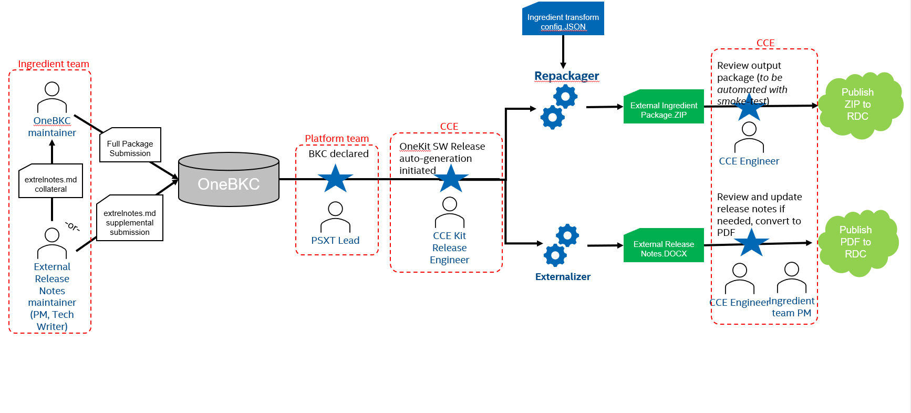
Final Goal of the Process
* Source: C4S

